Slide 1
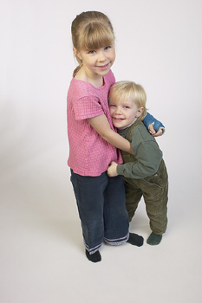
16-3 THE COMPARATIVE: USING -ER AND MORE
Nicola is taller than Bradley.

Slide 2
16-3 THE COMPARATIVE: USING -ER AND MORE
(a) Nicola is taller than Bradley.
Nicola is more tall than Bradley.
?

Slide 3
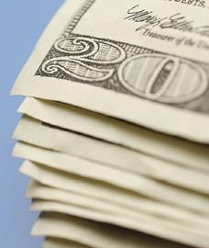
16-3 THE COMPARATIVE: USING -ER AND MORE
(b) Happiness is more important than money.
Happiness is importanter than money.
?

Slide 4
16-3 THE COMPARATIVE: USING -ER AND MORE
(a) Nicola is taller than Bashir.
(b) Happiness is more important than money.
To compare two persons or things:
-er
more
adjective +
+ than

Slide 5
16-3 THE COMPARATIVE: USING -ER AND MORE
ADJECTIVE COMPARATIVE
big
big
cheap
old
funny
pretty
er
g
ADJECTIVES WITH
ONE SYLLABLE
ADJECTIVES
THAT END IN -Y
cheap
old
er
er
funn
prett
ier
ier
y
y

Slide 6
16-3 THE COMPARATIVE: USING -ER AND MORE
ADJECTIVE COMPARATIVE
famous
important
interesting
good
bad
far
more famous
more important
more interesting
ADJECTIVES WITH
TWO OR MORE
SYLLABLES
IRREGULAR
COMPARATIVE
FORMS
better
worse
farther/further

Slide 7
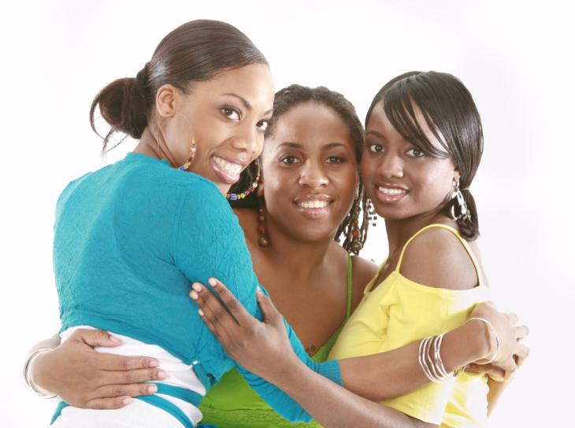
16-3 Let’s Practice
old
Ivana is ____ than Paris.
older
Paris 17
Ivana 19
Justine 15

Slide 8
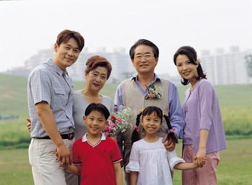
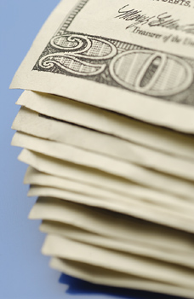
16-3 Let’s Practice
important
more important
Family is _____________ than money.

Slide 9
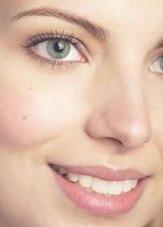
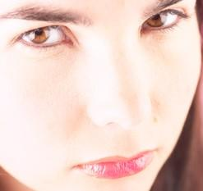
16-3 Let’s Practice
happy
happier
The woman with the smile looks ______ than the woman with the frown.

Slide 10

16-4 Let’s Practice
tall
Justine is ______than Paris.
Justine is the ________ than Ivana.
taller
shorter
Paris
Ivana
Justine

Slide 11
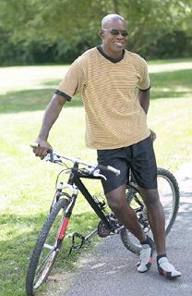
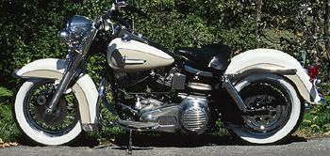
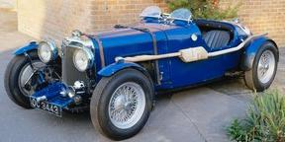
16-4 Let’s Practice
expensive
A good bicycle is expensive.
A motorcycle is more expensive.
A car is ______________ than a motorcycle
more expensive

Slide 12
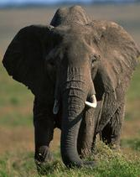
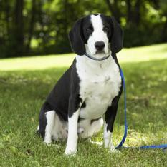
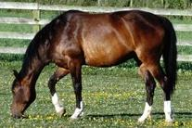
16-4 Let’s Practice
heavy
A horse is ________than a dog.
An elephant is __________ than a horse.
heavier
heavier

Slide 13
16-4 THE SUPERLATIVE: USING -EST AND MOST
We have a big family.
My brother is older than me.
Grandpa is the oldest of all.
My brother
Me

Slide 14
16-4 THE SUPERLATIVE: USING -EST AND MOST
(a) COMPARATIVE
My brother is older than me.
(b) SUPERLATIVE
Grandpa is the oldest of all.

Slide 15
16-4 THE SUPERLATIVE: USING -EST AND MOST
ADJECTIVE COMPARATIVE SUPERLATIVE
old
big
older
bigger
the oldest
the biggest
ADJECTIVES
WITH ONE
SYLLABLE

Slide 16
16-4 THE SUPERLATIVE: USING -EST AND MOST
ADJECTIVE COMPARATIVE SUPERLATIVE
ADJECTIVES
THAT END
IN -Y
pretty
easy
prettier
easier
prettiest
easiest

Slide 17
16-4 THE SUPERLATIVE: USING -EST AND MOST
ADJECTIVE COMPARATIVE SUPERLATIVE
ADJECTIVES
WITH TWO
OR MORE
SYLLABLES
more
expensive
more
important
the most
expensive
the most
important
expensive
important

Slide 18
16-4 THE SUPERLATIVE: USING -EST AND MOST
ADJECTIVE COMPARATIVE SUPERLATIVE
good
bad
far
better
worse
farther/
further
the best
the worst
the
farthest/
furthest
IRREGULAR
FORMS

Slide 19
16-4 Let’s Practice
tall
Justine is ______than Paris.
Ivana is the ____________ the sisters.
taller
tallest of all
Paris
Ivana
Justine

Slide 20
16-4 Let’s Practice
expensive
A good bicycle is expensive.
A motorcycle is more expensive.
A car is ______________________.
the most expensive (of all)

Slide 21
16-4 Let’s Practice
heavy
A horse is ________than a dog.
An elephant is __________ of all.
heavier
the heaviest

Slide 22
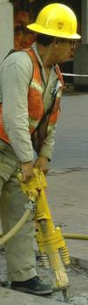
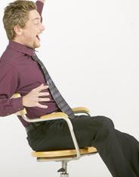
16-8 MAKING COMPARISONS WITH ADVERBS
Jake works harder than Hal (does).

Slide 23
16-8 MAKING COMPARISONS WITH ADVERBS
COMPARATIVE
(a) Jamie works more quickly than Pat (does).
(b) Ben works the most quickly of all.
SUPERLATIVE
COMPARATIVE
adverbs ending in -ly
SUPERLATIVE
adverbs ending in -ly
the most
the most
the most
more
more
more
carefully
neatly
slowly

Slide 24
16-8 MAKING COMPARISONS WITH ADVERBS
COMPARATIVE
(c) Angie works faster than Debbie (does).
(d) Melissa works the fastest of all.
SUPERLATIVE
hard, fast, early, late
-er and -est with irregular adverbs

Slide 25
16-8 MAKING COMPARISONS WITH ADVERBS
COMPARATIVE
(e) Most people sing better than I (do).
(f) Steve sings the best of all.
SUPERLATIVE
better
best
forms of
well

Slide 26
16-8 Let’s Practice
Sully had a good score on the English test.
COMPARATIVE
Merna had a ______ score.
SUPERLATIVE
Paula had _______ score
of all.
English Test
better
Paula 100%
Merna 88%
Sully 75%
the best

Slide 27
16-8 Let’s Practice
I have to get up early on Monday.
COMPARATIVE
I have to get up _______ on Tuesday.
SUPERLATIVE
I have to get up _________ on Friday.
earlier
the
earliest

Slide 28
16-8 Let’s Practice
Simone can run quickly.
COMPARATIVE
Majid can run ____________.
SUPERLATIVE
Larry can run _______________ of all.
more quickly
the
most quickly

